Slide 1
FOXY Glasses Store
TEAM PROJECT 3 -
Prof. Machuria M. Johnson
ITSE 1346 17591

Slide 2
TEAM MEMBERS
Mai Tran
Nguyen Tuan Pham
Josue Rodriguez
Daniel Macias
Ivory Ibe
Trung Nguyen
Macfrancis Belchi

Slide 3
CONTENT
Overview
Project objective
Issues - Assumptions - Adjustment
Data Normalization - ER Diagram
Reports
Forms
User Interface
Project timeline
Conclusion

Slide 4
OVERVIEW
Develop a database used by small optical businesses.
Foxy Optical provides us with data in XML format.
Utilize Microsoft Access to develop a new database.
Also produces required reports/forms for our client.
“Our goal was to create a Clean, Accurate, Relevant and Reliable (CARR) Record Keeping System for Foxy Optical.”

Slide 5
PROJECT TIMELINE
Week 1
Week 2
Week 3
Week 4
Week 5
Week 6
Project Requirements
Data Dictionary
Data Normalization
Create Reports/Forms
Write the Report
Prepare for Presentation
Clarify Project Requirements
Analyze the context,
build Data Dictionary
Normalize the data to the 3rd form. Remove the data duplicates. Format the tables. Create ER diagram.
Use the cleaned tables to produce Reports/Forms
Write the Overview and Assumptions based on our database. Provide the completed Reports/Forms.
Use PowerPoint for the presentation.

Slide 6
ISSUES - ASSUMPTIONS - ADJUSTMENTS
Issues | Assumptions | Adjustments
Multiple Doctors with missing ID and information | Input Error | Assign new IDs by adjust ID of NONE to 0
Customer with multiple last visit | Last visits were not correctly updated | Use the latest visit date
Customer with multiple current balance | Current balance were not correctly updated | Use the latest current balance
Customer with multiple last pay | Last pays were not correctly updated | Use the latest pay date

Slide 7



DATA NORMALIZATION
Tables normalized to Third Normal Form (3NF).
3NF ensures ease of database maintenance.
Reduces redundancy and maintains consistent dependency.
Establishing relationship between tables allows for flexibility.

Slide 8
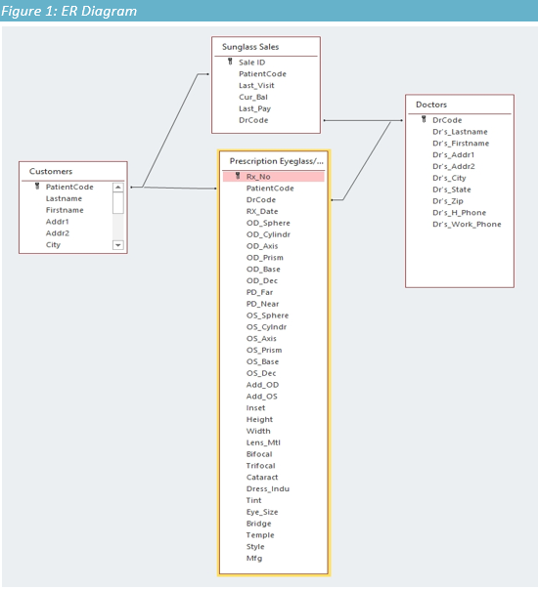
ER DIAGRAM
Shows objects and their resulting relationships.
Data normalized to Third Normal Form (3NF).
Data-flow diagram allows for effective visual representation.

Slide 9

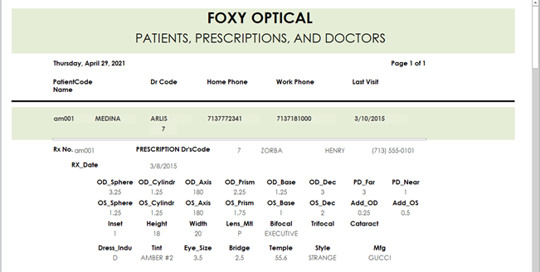
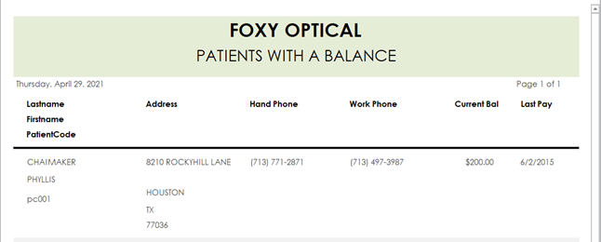
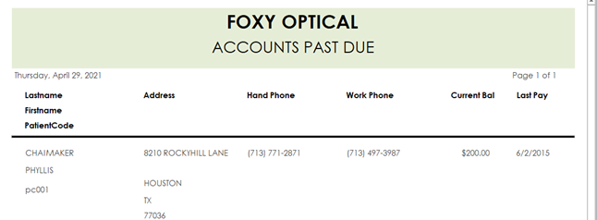
REPORTS
Create 6 Reports
Current Patients
Doctors & their Patients
Patients Prescriptions & Doctors
Retail Customers Only (Patients w/o prescription)
Open Patient Accounts
Accounts Past Due

Slide 10
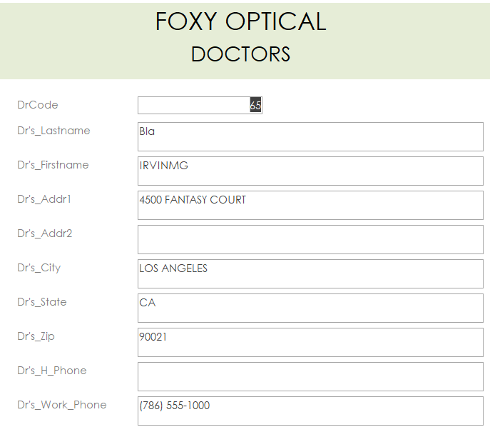
FORM - DOCTORS
To keep track of doctors information.
To record each of the doctors demographic.
To provide a form of contact for the doctors.

Slide 11
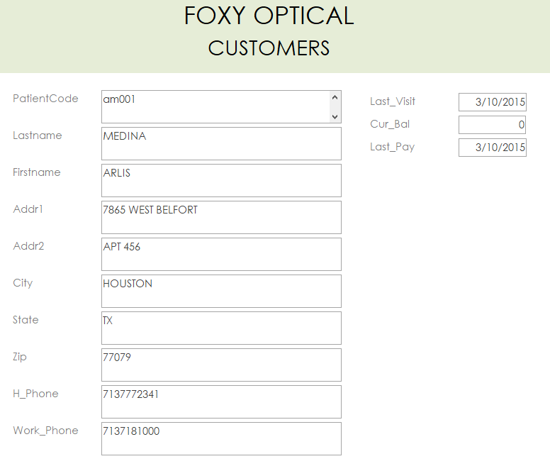
FORM - PATIENTS
To provide a form of contact for patients.
Keeps track of the patients last visit, their balance, and when they last paid.
Includes the patients information and contact, so it will be easier to track.

Slide 12
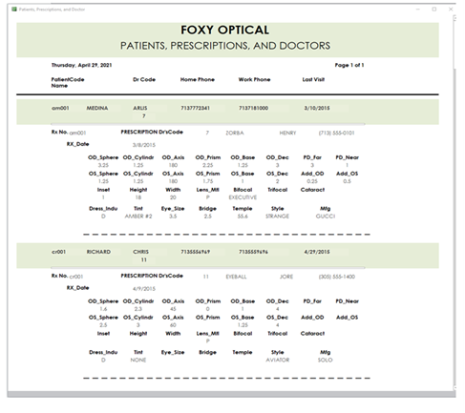
FORM - EYEGLASSES/CONTACT SALES
For every doctor appointment;
The patient registry is created or updated for a returning patient.
The assigned doctor code and prescription is recorded.
The payment received and balance due is also recorded.
As previewed here and on next slide

Slide 13
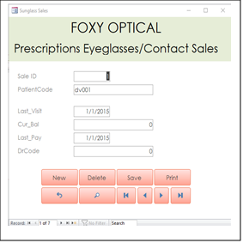

FORM - PRESCRIPTION
Patients are required to fill out a form registry indicating prescription from assigned doctor

Slide 14
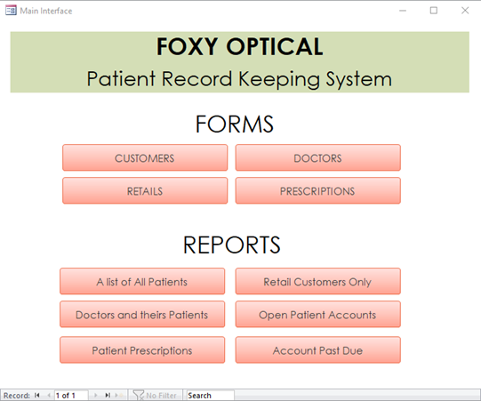
USER INTERFACE
To make the system become user-friendly.
Provide the navigation for users to use.
Help users to perform tasks with ease.
A Main Interface is needed for our system.

Slide 15
CONCLUSION
Creating an Accurate and Reliable Record was not easy.
Important to ensure all potential business situations.
Cleaning data is to produce the accurate results.
Normalization is the most important step in process.

Slide 16

Thank you!

